Slide 1

- Manage Census Inmates
- Set Alert && Undo Alert
- Manage Visitor Information
- Set Jailer Shift Hours
- Set Jailer Department

Slide 2
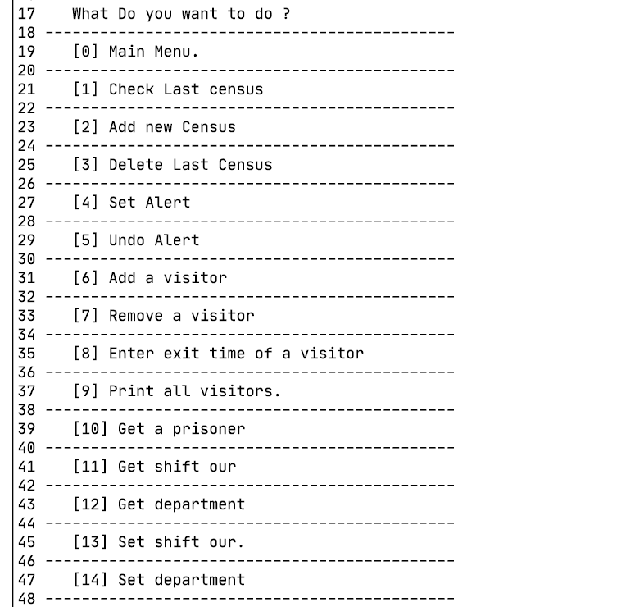
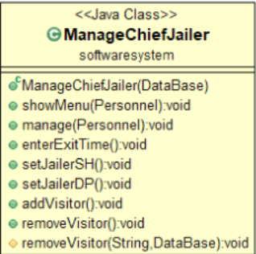
First of all, it is necessary to add chief jailer as staff in prison manage system. Then the chief jailer id and password must be entered. As a result, we will see this menu.
Manage Chief class class diagram

